Slide 1

Onboarding Presentation
TE 19

Slide 2
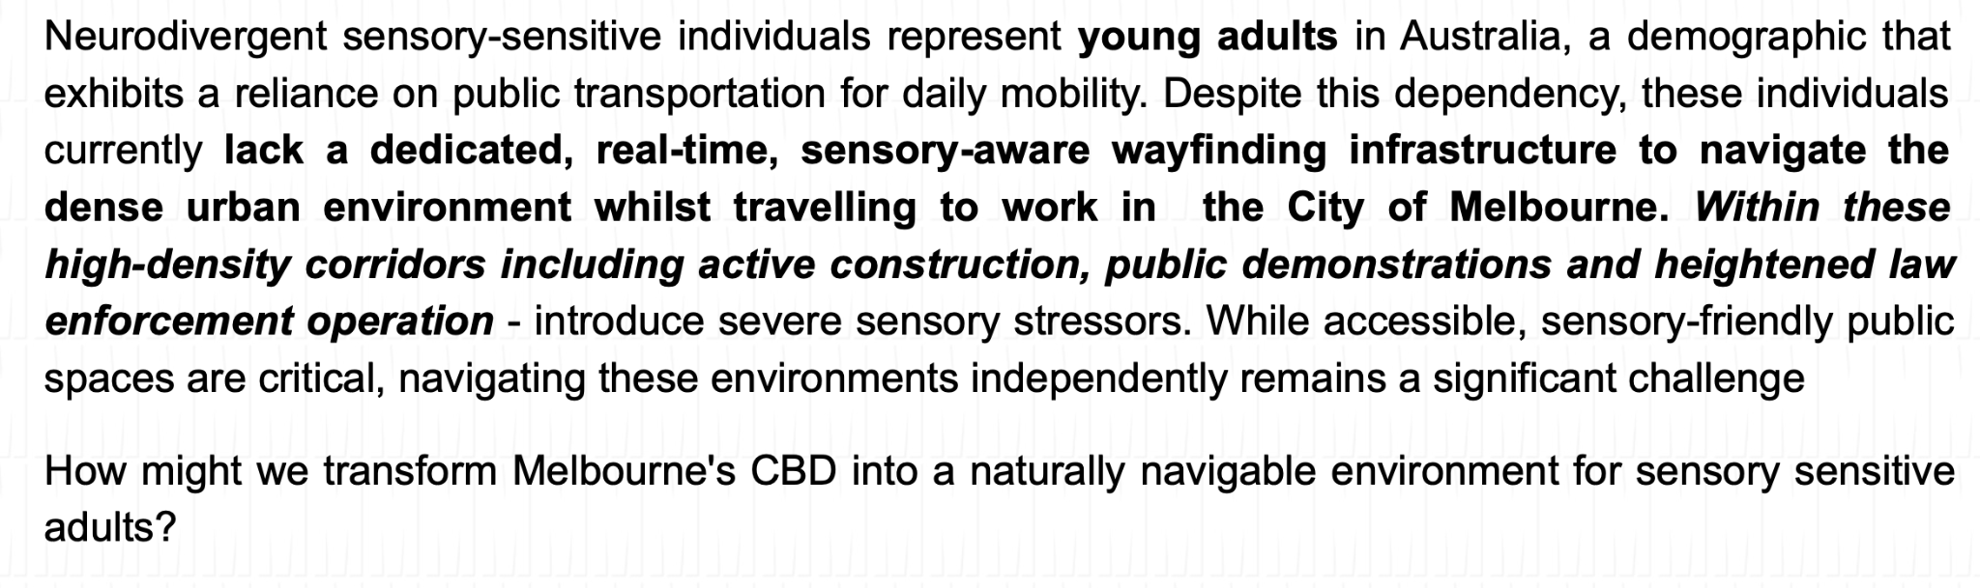
Problem Statement

Slide 3
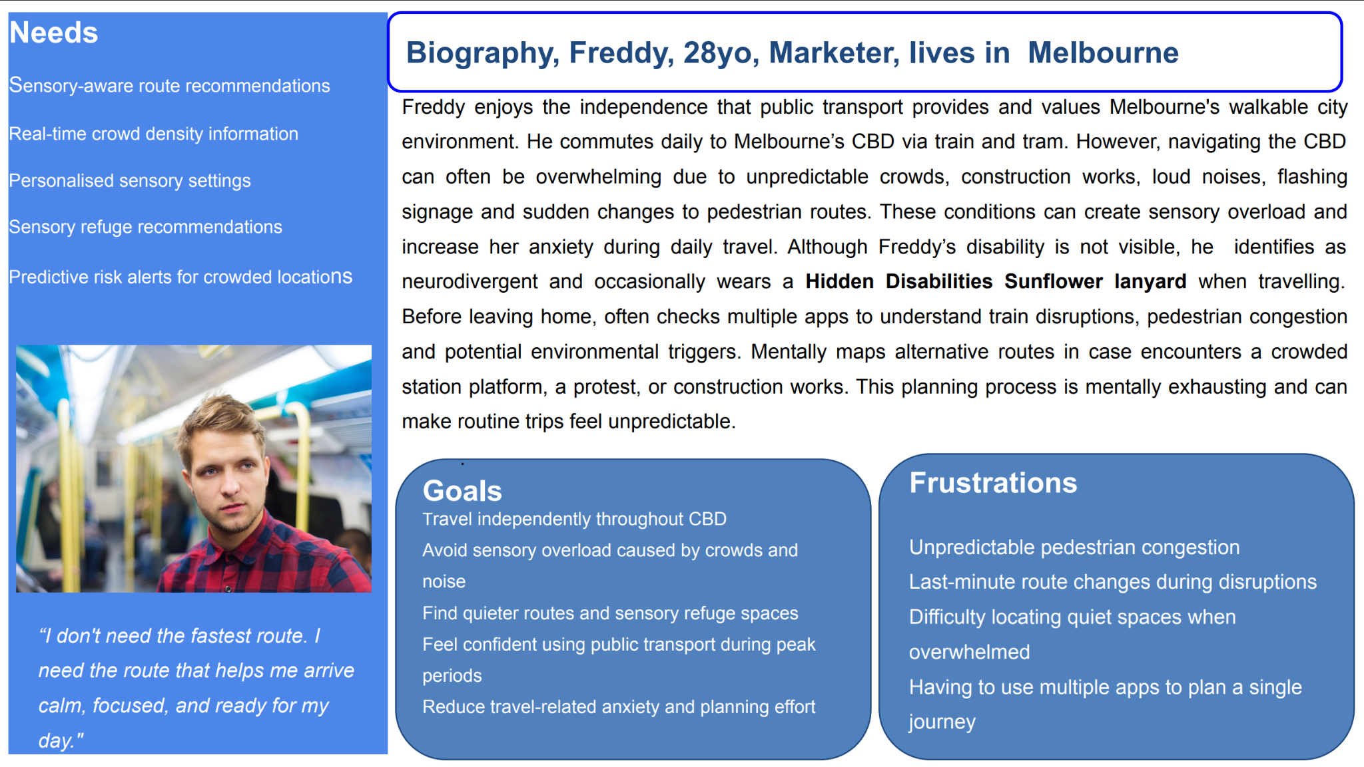
Persona

Slide 4
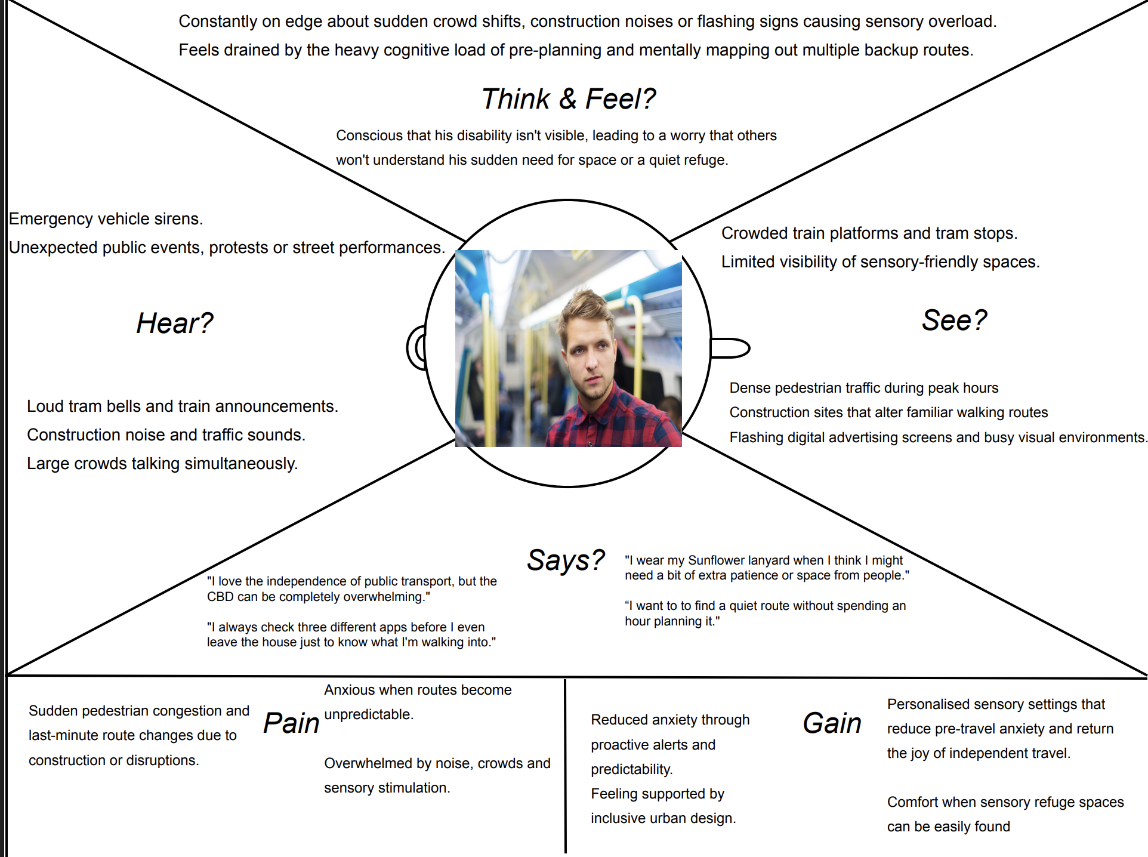
Empathy Map

Slide 5
Plan for the Iteration
Epic
Epic 1: Sensory-Aware Route Planning & Real-Time Navigation
Description：
Enable neurodivergent and sensory-sensitive adults to independently navigate Melbourne CBD using routes optimized for lower sensory load rather than shortest travel time.
Benefits:
Reduce exposure to high-density pedestrian areas.
Increase confidence in independent travel.
Improve route completion rates without sensory distress.
Increase adoption of sensory-friendly route recommendations.

Slide 6
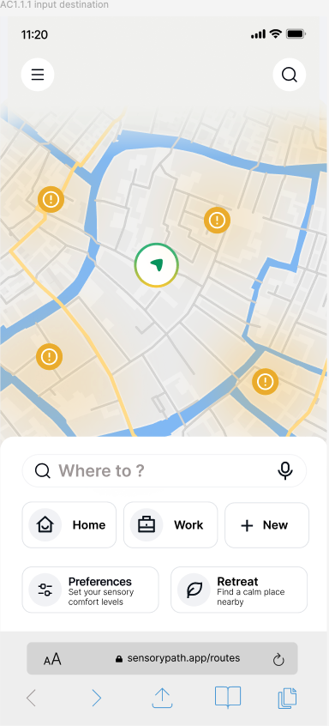
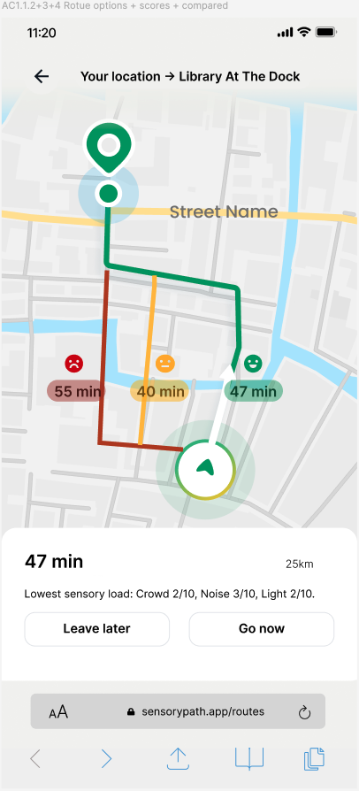
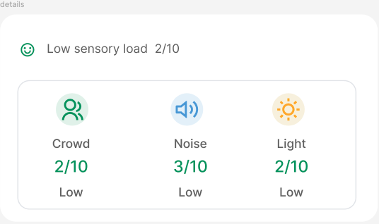

Plan for the Iteration
Planned US, Features, AC, and Prototype overview
Prototype
User Stories
F1.Destination Search
F2.Route Comparison
US 1.1 As a sensory-sensitive commuter, I want to see a sensory indicator (High or Low) for different routes, so that I can choose the path that feels safest and least overwhelming.
F3.Sensory Score Breakdown
Acceptance Criteria
# | Given | When | Then
AC 1.1.1 | A start point and destination are entered. | The user searches for routes. | Two to three route options are displayed.
AC 1.1.2 | Route options are available. | The comparison results are shown. | Each route displays time, distance and sensory scores.
AC 1.1.3 | Sensory scores are calculated. | The user views the routes. | Each route shows a High or Low sensory indicator.
AC 1.1.4 | Routes are compared. | Results are presented. | Routes are labelled as Lowest Sensory Load, Balanced or Fastest.

Slide 7
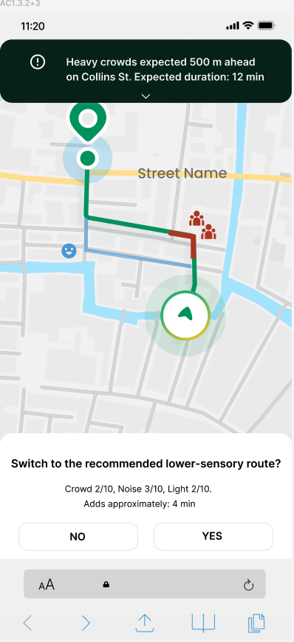
Plan for the Iteration
Planned US, Features, AC, and Prototype overview
Prototype
User Stories
US 1.2 As a sensory-sensitive commuter, I want to avoid highly congested pedestrian corridors, so that I can reduce exposure to crowd-related stress.
F4.Congestion Forecast
Acceptance Criteria
F5.Congested Corridor Highlight
# | Given | When | Then
AC 1.2.1 | Route congestion data is available. | The system analyses possible routes. | Highly congested corridors are predicted.
AC 1.2.2 | User preferences and sensory scores are available. | Sensory load is calculated. | Crowd, noise and light scores are weighted based on user preferences.
AC 1.2.3 | All route sensory loads are calculated | Recommendations are shown | The route with the lowest personalised sensory load is recommended
F6.Personalised Lower-Sensory Route Recommendation

Slide 8
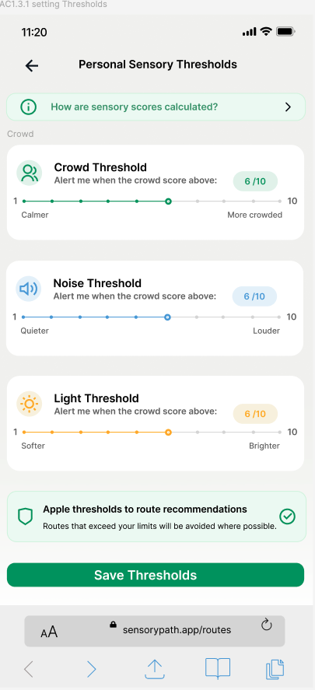
Plan for the Iteration
Planned US, Features, AC, and Prototype overview
Prototype
F7.Threshold Settings
User Stories
US 1.3 As a sensory-sensitive commuter during peak hour, I want alternative low-stimulation routes when crowd density exceeds my preferred threshold, so that I can avoid unexpected sensory overload.
F8.Sensory Score & Threshold Guide
Acceptance Criteria
# | Given | When | Then
AC 1.3.1 | The user is on the sensory settings page. | The user selects and saves crowd, noise and lighting sensitivity levels. | The system stores and applies the user’s personal sensory thresholds.
AC 1.3.2 | Personal thresholds are saved and route guidance is active. | The current or upcoming sensory conditions exceed a threshold. | The system alerts the user and shows the trigger, location, distance and expected duration.
AC 1.3.3 | The current route exceeds a threshold and a lower-sensory route is available. | The system compares alternative routes. | A lower-sensory route is recommended and can be selected for rerouting.
F9.Threshold Alert Settings

Slide 9
Plan for the Iteration
Epic
Epic 2: Sensory Environment Monitoring
Description：
Provide real-time visibility of sensory stressors across the CBD and enable users to make informed navigation decisions before entering overwhelming environments.
Benefits:
Reduce unexpected exposure to sensory triggers.
Increase successful rerouting before reaching high-stimulation zones.
Improve user perception of safety and comfort.
Increase usage of identified sensory refuge locations.

Slide 10
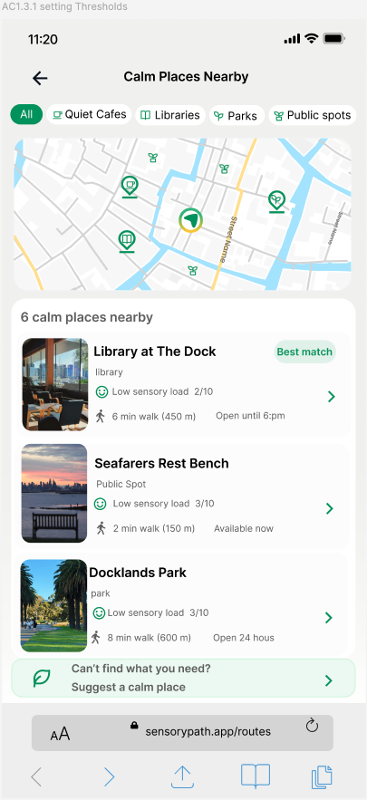
Plan for the Iteration
Planned US, Features, AC, and Prototype overview
Prototype
F10.Nearby Calm Place Discovery
User Stories
US 2.1 As a sensory-sensitive commuter, I want to identify nearby sensory refuge locations such as parks, libraries and quiet public spaces so that I can take breaks when feeling overwhelmed.
F11.Calm Place Category Filters
Acceptance Criteria
F12.Calm Place Ranking
# | Given | When | Then
AC 2.1.1 | The user’s current location is available. | The user searches for nearby quiet spaces. | Nearby parks, libraries and quiet public spaces are identified.
AC 2.1.2 | Potential refuge locations are available. | The system evaluates distance, opening hours and predicted sensory load. | Suitable quiet spaces are ranked and recommended.
AC 2.1.3 | Recommendations have been generated. | The user views the results. | Each place displays sensory load, distance, opening hours, walking time.
AC 2.1.4 | The user selects a refuge location. | The user chooses navigation. | Walking directions to the selected location are displayed.
AC 2.1.5 | The user is on the Add a Calm Place page. | They enter and submit the place details. | The new place is saved for review.
F13.Sensory & Place Information
F14.Walking Navigation
F15.Suggest a Calm Place

Slide 11
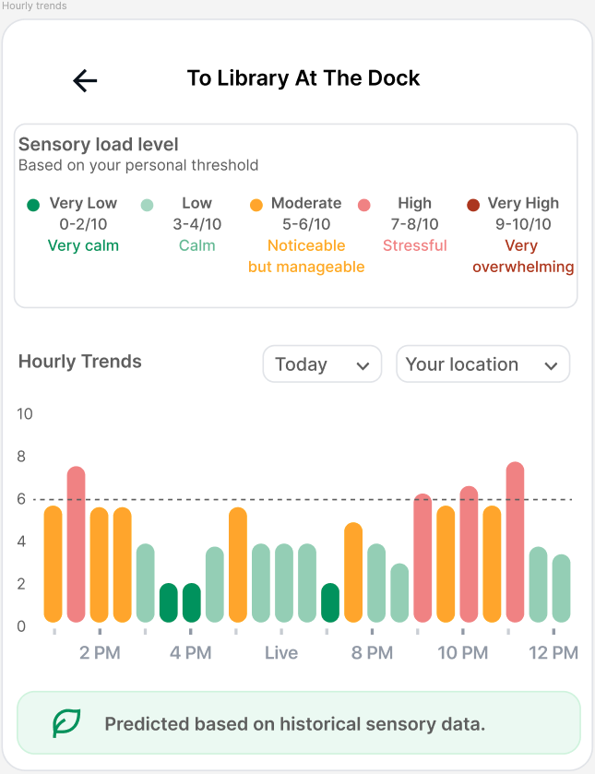
Plan for the Iteration
Planned US, Features, AC, and Prototype overview
Prototype
User Stories
US 2.2 As a sensory-sensitive commuter, I want predictive alerts showing which areas are likely to become overwhelming within the next hour, so that I can adjust my travel plans proactively.
F16. Hourly Sensory Load Forecast
Acceptance Criteria
# | Given | When | Then
AC 2.2.1 | An area is selected. | The user views the forecast. | A bar chart shows the predicted sensory load for the next hour.
AC 2.2.2 | A personal threshold is set. | The forecast chart is displayed. | Values below the threshold appear green; values above it appear red.
F17. Colour-Coded Sensory Load Levels

Slide 12
Open Data: 11 Sources
Live crowd sensing (real time)
●Pedestrian Counting System: counts per minute + sensor locations.
●134 sensors, ~50,000 readings per rolling hour, 5-minute refresh.
Forecasting (daily)
●Pedestrian counts per hour: 268,000 rows over a 120-day window.
●16,500 hourly profiles (sensor x weekday x hour) power next-hour forecasts.
Sensory proxies (per iteration)
●223 live music venues, 301 bars with patron capacity (CLUE 2024).
●10,300 street lights with lux levels, 53 active construction sites.
●Declared proxies: crowds are measured; the city publishes no live noise feed.
Refuges and basemap (per iteration)
●3,242 refuges in 3 tiers: landmarks, street furniture, public toilets.
●OpenStreetMap walkable graph: 70,614 street edges across the CBD.
Data: City of Melbourne Open Data, licensed CC BY 4.0. Map data: (c) OpenStreetMap contributors, licensed ODbL.

Slide 13
Innovation
Time-Shifting, Not Just Re-Routing
Predicts how a route’s sensory load will change over time.
Suggests a better departure time, not only a different path.
Example: “Leave 12 minutes later and this route changes from High to Low.”
Uses existing hourly pedestrian patterns, requiring minimal additional development.
Micro-Refuges as First-Class Navigation Targets
Treats public seats, drinking fountains and quiet laneways as navigable sensory refuges.
Shows the nearest refuge throughout the journey.
Example: “A sensory refuge is 90 seconds away.”
Creates a dense support network beyond traditional parks and libraries.
Community-Verified Calm Place
Allows users to suggest calm places that are missing from official datasets.
Captures local knowledge and lived experience.
Reviews suggestions before adding them to the map.
Continuously expands the sensory-refuge network.

Slide 14
Security Plan
Protecting sensitive user data
●Sensory thresholds reveal disability status, so they are handled as sensitive information under the Privacy Act 1988.
●Explicit consent is captured at sign-up and sensory profiles are never shared with third parties.
●Data minimisation — we store threshold values only, never a diagnosis or condition.
●Route history is not persisted and coordinates are truncated before storage.
Authentication and access control
●Passwords require at least 9 alphanumeric characters and are hashed with bcrypt, never stored in plain text.
●Session tokens expire automatically and re-authentication is required to change a sensory profile.
●Server-side authorisation on every profile endpoint, so one user can never retrieve another user’s settings.
●All traffic is served over HTTPS with TLS enforced.

Slide 15
Risk Assessment
# | Risk | Rating | Mitigation
1 | Broken authentication on sensory profile endpoints | High | 9+ character alphanumeric password policy, hashed storage, token expiry and server-side authorisation on every request
2 | Exposure of disability-related personal data | High | Classify as sensitive information, minimise stored fields, encrypt at rest, consent captured at collection
3 | API keys exposed in the client bundle | High | All City of Melbourne and OpenStreetMap calls routed through a backend proxy; keys held server-side only
4 | Corrupted or stale open data producing unsafe route advice | Medium | Range validation on incoming feeds, staleness timestamps shown to the user, degraded-mode messaging
5 | Unrestricted routing endpoint abused for denial of service | Medium | Rate limiting per IP and per session on the route calculation service
6 | Vulnerable npm dependencies | Medium | Automated npm audit in the build pipeline; patch before each release
7 | Open ports and unused services on the deployment host | Low | Close all unwanted ports and disable services not required by the build

Slide 16
Penetration Testing
Quality assurance of project code
●eslint-plugin-security and TypeScript strict mode run on every commit to catch unsafe patterns early.
●npm audit in the build pipeline flags dependency vulnerabilities before release.
●Secret scanning enabled and .env excluded from Git, so no credentials reach the repository.
●A security checklist item is required in every peer code review before a branch is merged.
Penetration testing and documentation (MCS)
●Testing is performed only against our own deployed build; brute force attacks are strictly prohibited.
●OWASP ZAP baseline scan, then manual testing of authorisation bypass, injection on the destination field and session handling.
●Findings documented with screenshots, then an impact assessment table against confidentiality, integrity and availability.
●Recommendations prioritised by impact and ease of implementation, uploaded to the PGP Security folder at build submission.

Slide 17
Reference
Aminpour, F. (2025, October 24). Designing cities for neurodiversity—Why we need inclusive public open spaces. City Futures Research Centre Blog. https://blogs.cityfutures.unsw.edu.au/news/designing-cities-neurodiversity-why-we-need-inclusive-public-open-spaces
Carayol, C. (2026, March 11). Designing for neurodivergence makes life better according to new research. Architecture & Design. https://www.architectureanddesign.com.au/editorial/industry-news/designing-cities-for-neurodivergent-people-makes-urban-life-better-for-everyone
Hidden Disabilities Sunflower. (n.d.). Metro Trains in Melbourne launch the Hidden Disabilities Sunflower. https://hdsunflower.com/au/insights/post/metro-australia-launch-the-hidden-disabilities-sunflower

Slide 18
THANKS！

